Slide 1
Chapter 3 Selections
Liang, Introduction to Java Programming, Tenth Edition, (c) 2015 Pearson Education, Inc. All rights reserved.

Slide 2
Objectives
To implement selection control using one-way if statements.
To implement selection control using two-way if-else statements.
To implement selection control using nested if and multi-way if statements.
To avoid common errors and pitfalls in if statements.
To implement selection control using switch statements.
To write expressions using the conditional expression.
To combine conditions using logical operators (&&, ||, and !) .
To examine the rules governing operator precedence and associativity.
Liang, Introduction to Java Programming, Tenth Edition, (c) 2015 Pearson Education, Inc. All rights reserved.

Slide 3
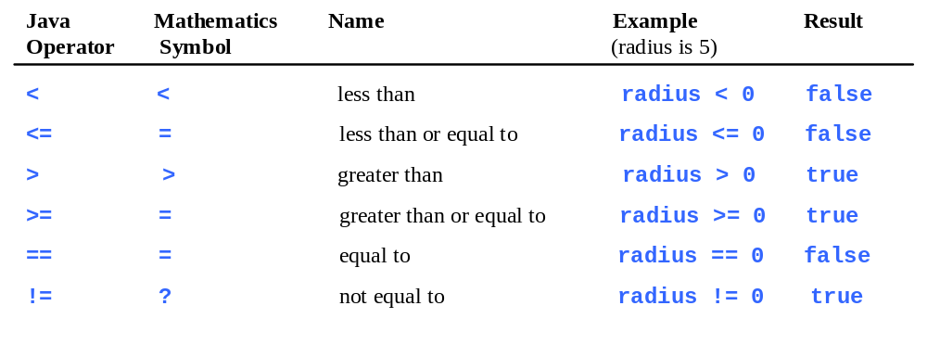
Relational Operators
Java provides six comparison operators (also known as relational operators) that can be used to compare two values.

Slide 4
The boolean Type
The result of the comparison is a Boolean value: true or false.
boolean b = (1 > 2); //boolean and not bool

Slide 5
One-way if Statements
if (boolean-expression) {
statement(s);
}
if (radius >= 0) {
area = radius * radius * PI;
System.out.println("The area for the circle of radius " + radius + " is " + area);
}

Slide 6
The Two-way if Statement
if (boolean-expression) {
statement(s)-for-the-true-case;
}
else {
statement(s)-for-the-false-case;
}
if (radius >= 0) {
area = radius * radius * 3.14159;
System.out.println("The area for the circle of radius " + radius + " is " + area);
}
else {
System.out.println("Negative input");
}

Slide 7
Multiple Way if Statements
if (score >= 90.0)
System.out.print("A");
else if (score >= 80.0)
System.out.print("B");
else if (score >= 70.0)
System.out.print("C");
else if (score >= 60.0)
System.out.print("D");
else
System.out.print("F");

Slide 8


NOTE

Slide 9
Random Numbers
You can use Math.random() to obtain a random double value between 0.0 and 1.0, excluding 1.0.
In general, to produce a random number between a Min and a Max including the Max
Min + (int)(Math.random() * ((Max - Min) + 1))
(int)(Math.random() * 10) returns a random single-digit integer (i.e., a number between 0 and 9).

Slide 10

Problem: A Math Learning Tool
This example creates a program to teach a first-grade child how to learn subtractions. The program randomly generates two single-digit integers number1 and number2 with number1 >= number2 and displays a question such as “What is 9 – 2?” to the student. After the student types the answer, the program displays whether the answer is correct.
SubtractionQuiz

Slide 11
Logical Operators
The logical operators !, &&, ||, and ^ can be used to create a compound Boolean expression.
Operator | Name | Description
! | not | logical negation
&& | and | logical conjunction
|| | or | logical disjunction
^ | exclusive or | logical exclusion

Slide 12
Truth Table for Operator !
p | !p | Example (assume age = 24, weight = 140)
true | false | !(age > 18) is false, because (age > 18) is true.
false | true | !(weight == 150) is true, because (weight == 150) is false.

Slide 13
Truth Table for Operator &&
p₁ | p₂ | p₁ && p₂ | Example (assume age = 24, weight = 140)
false | false | false | (age <= 18) && (weight < 140) is false, because (age > 18) and (weight <= 140) are both false.
false | true | false
true | false | false | (age > 18) && (weight > 140) is false, because (weight > 140) is false.
true | true | true | (age > 18) && (weight >= 140) is true, because both (age > 18) and (weight >= 140) are true.

Slide 14
Truth Table for Operator ||
p₁ | p₂ | p₁ || p₂ | Example (assume age = 24, weight = 140)
false | false | false
false | true | true | (age > 34) || (weight <= 140) is true, because (age > 34) is false, but (weight <= 140) is true.
true | false | true | (age > 14) || (weight >= 150) is false, because (age > 14) is true.
true | true | true

Slide 15
Truth Table for Operator ^
p₁ | p₂ | p₁ ^ p₂ | Example (assume age = 24, weight = 140)
false | false | false | (age > 34) ^ (weight > 140) is true, because (age > 34) is false and (weight > 140) is false.
false | true | true | (age > 34) ^ (weight >= 140) is true, because (age > 34) is false but (weight >= 140) is true.
true | false | true | (age > 14) ^ (weight > 140) is true, because (age > 14) is true and (weight > 140) is false.
true | true | false

Slide 16
Example of ^ Operator
Suppose project groups each with two students should have one CS Major and one Non-CS Major.
if((student1==“csMajor”)^ (student2==“csMajor”))
System.out.println("Valid Project Group");
else
System.out.println("InValid Project Group");

Slide 17
&& and || vs. & and | Operators
When evaluating p1 && p2, Java first evaluates p1 and then, if p1 is true, evaluates p2; if p1 is false, it does not evaluate p2.
When evaluating p1 || p2, Java first evaluates p1 and then, if p1 is false, evaluates p2; if p1 is true, it does not evaluate p2.
In programming language terminology, && and || are known as the short-circuit or lazy operators.
Java also provides the unconditional AND (&) and OR
(|) operators which evaluates both p1 and p2 under all conditions.

Slide 18
The & and | Operators
Example of an instance when you would not use short circuit operator
Consider the following example of checking a password for validity:
while ( password.isValid() & (attempts++ < MAX_ATTEMPTS) )
{
// re-prompt
}
If the second condition was not evaluated due to short-circuiting, attempts would never be incremented.

Slide 19
Problem: Determining Leap Year?
This program first prompts the user to enter a year as an int value and checks if it is a leap year.
A year is a leap year if it is divisible by 4 but not by 100, or it is divisible by 400.
LeapYear
Run

Slide 20
switch Statement
The switch statement executes statements based on the value of a variable or an expression.
The switch-expression must yield a value of char, byte, short, or int type and must always be enclosed in parentheses.
switch (switch-expression) {
case value1: statement(s)1;
break;
case value2: statement(s)2;
break;
…
case valueN: statement(s)N;
break;
default: statement(s)-for-default;
}
The value1, ..., and valueN must have the same data type as the value of the switch-expression. The resulting statements in the case statement are executed when the value in the case statement matches the value of the switch-expression. Note that value1, ..., and valueN are constant expressions, meaning that they cannot contain variables in the expression, such as 1 + x.

Slide 21
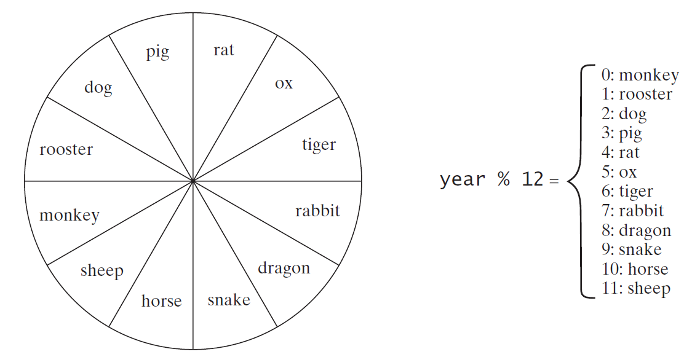
Problem: Chinese Zodiac
The Chinese Zodiac is based on a 12-year cycle, with each year represented by an animal.
Note year % 12 determines the Zodiac sign. 2019 is the year of the pig because 2019 % 12 is 3.
Write a program that prompts the user to enter a year and displays the animal for the year.
ChineseZodiac

Slide 22
Conditional Operator
Ternary Operator: (boolean-expression) ? expression1 : expression2
Example 1
if (x > 0)
y = 1
else
y = -1;
is equivalent to
y = (x > 0) ? 1 : -1;
Example 2
if (num % 2 == 0)
System.out.println(num + “is even”);
else
System.out.println(num + “is odd”);
The above is equivalent to writing the below:
System.out.println( (num % 2 == 0) ? num + “is even” : num + “is odd”);

Slide 23
Operator Precedence
var++, var--
+, - (Unary plus and minus), ++var,--var
(type) Casting
! (Not)
*, /, % (Multiplication, division, and remainder)
+, - (Binary addition and subtraction)
<, <=, >, >= (Relational operators)
==, !=; (Equality)
^ (Exclusive OR)
&& (Conditional AND) Short-circuit AND
|| (Conditional OR) Short-circuit OR
=, +=, -=, *=, /=, %= (Assignment operator)

Slide 24
Operator Associativity
When two operators with the same precedence are evaluated, the associativity of the operators determines the order of evaluation. All binary operators except assignment operator are left-associative.
a – b + c – d is equivalent to ((a – b) + c) – d
Assignment operators are right-associative. Therefore, the expression a = b += c = 5 is equivalent to a = (b += (c = 5))

Slide 25

Example
Applying the operator precedence and associativity rule, the expression 3 + 4 * 4 > 5 * (4 + 3) - 1 is evaluated as follows:

